Slide 1
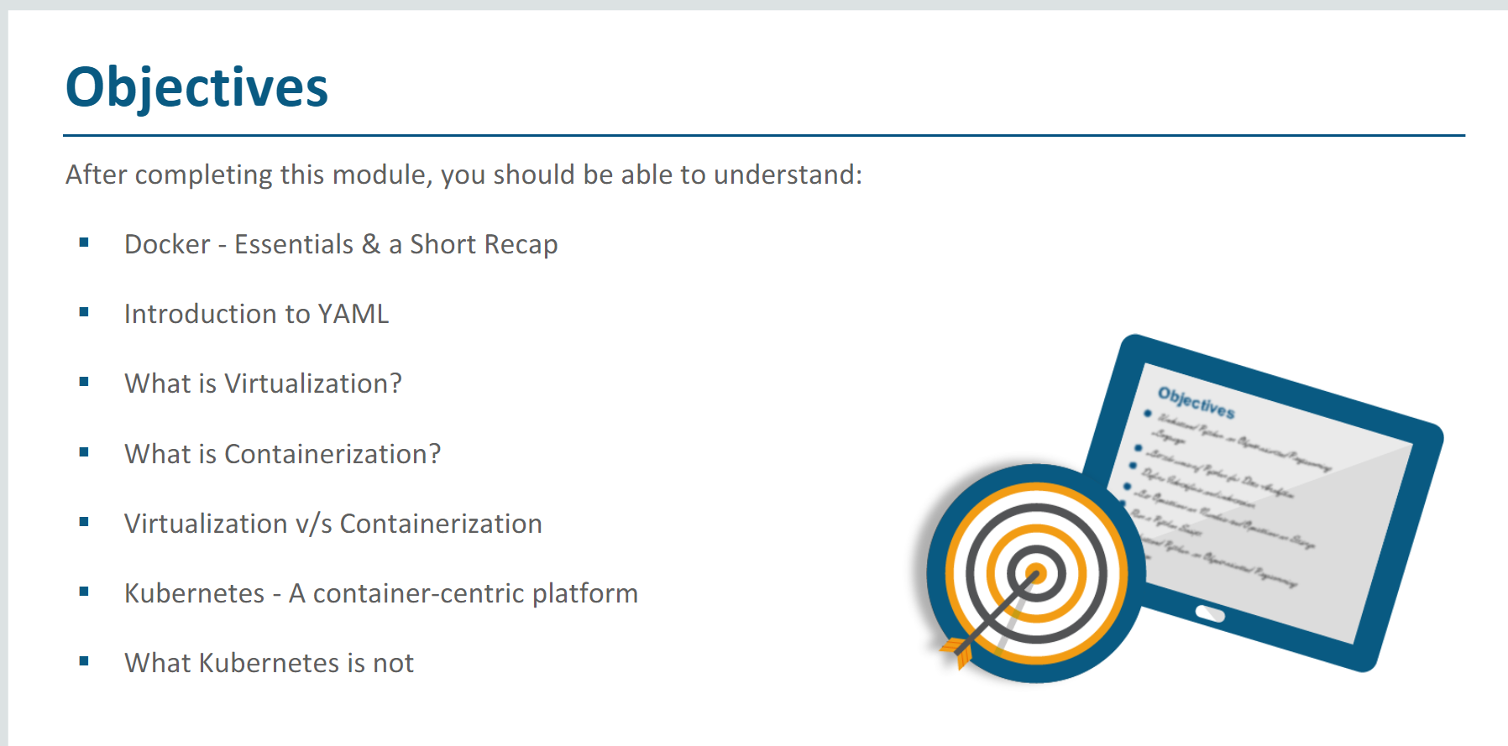

Slide 2
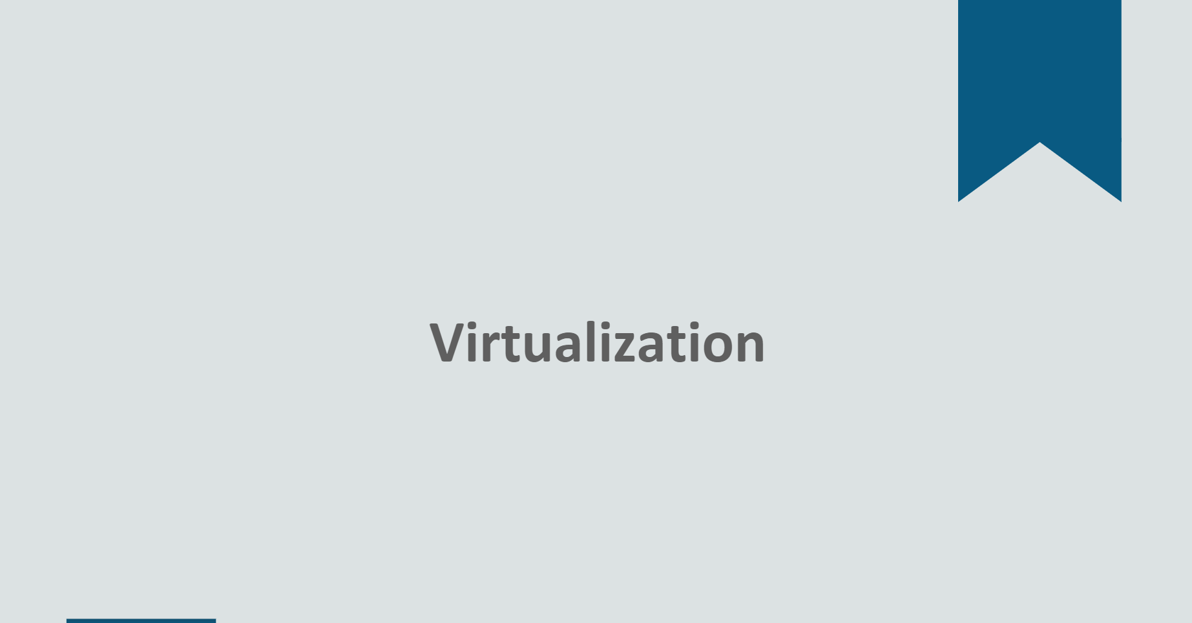

Slide 3
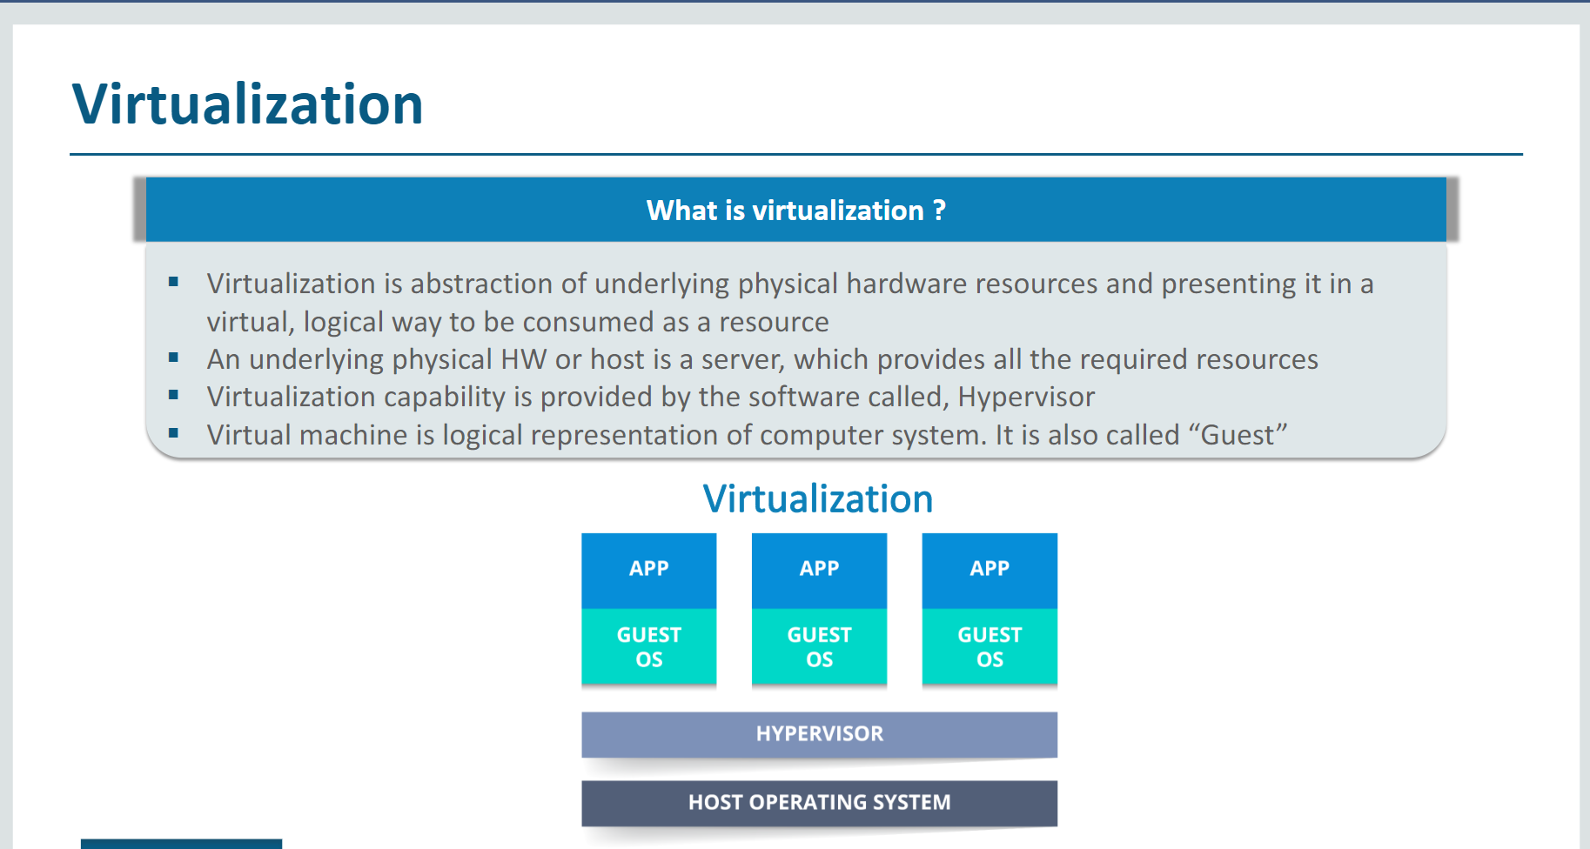

Slide 4
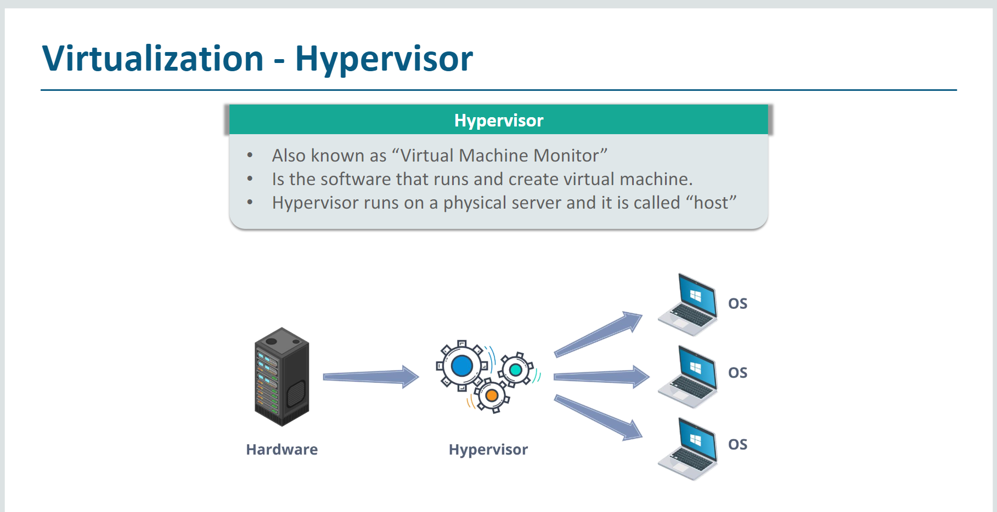

Slide 5
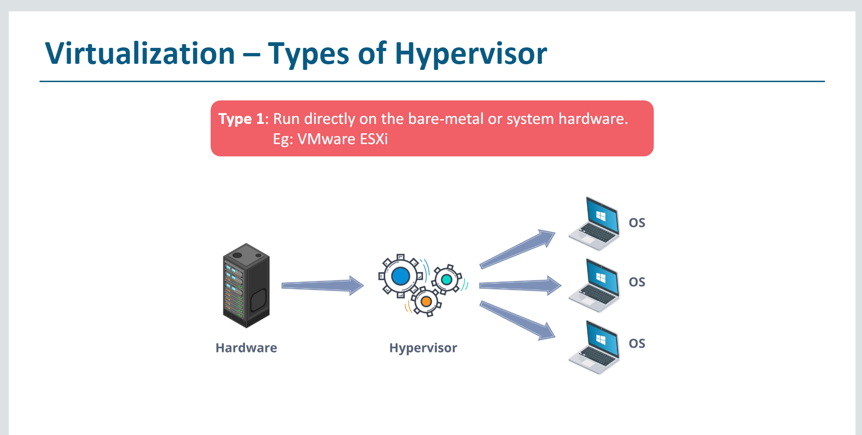

Slide 6
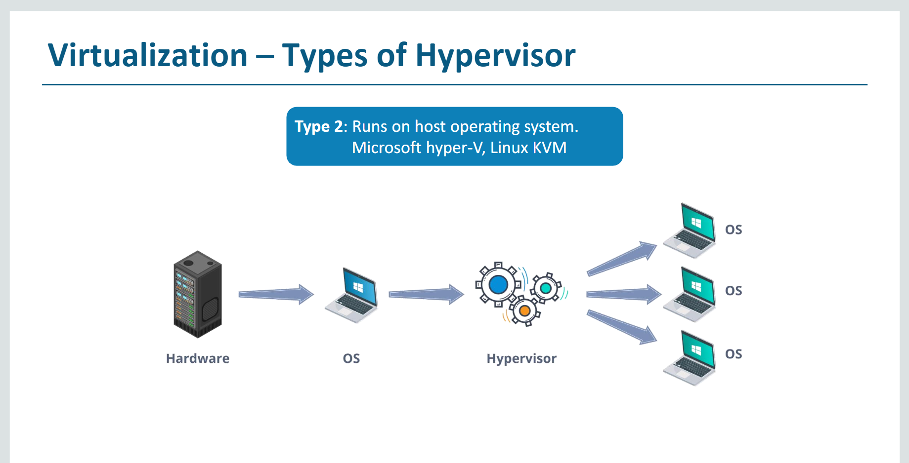

Slide 7
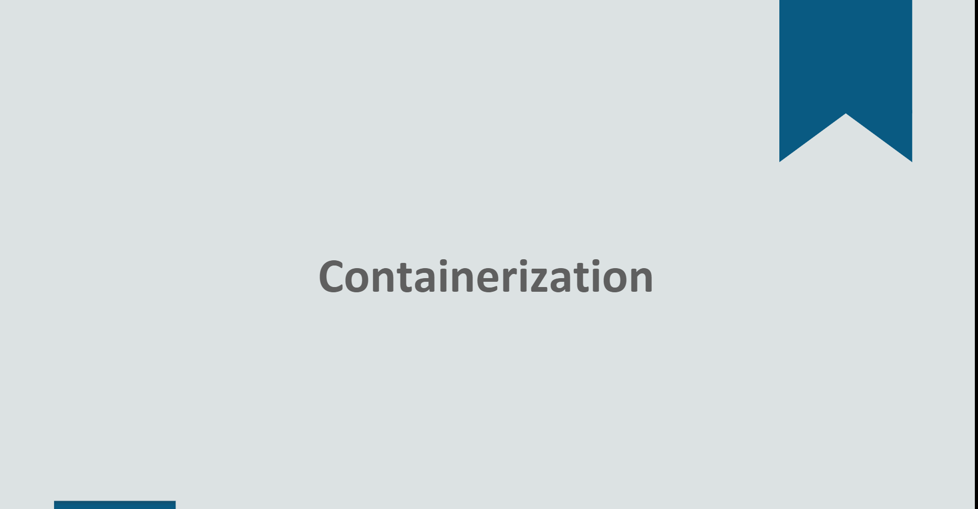

Slide 8
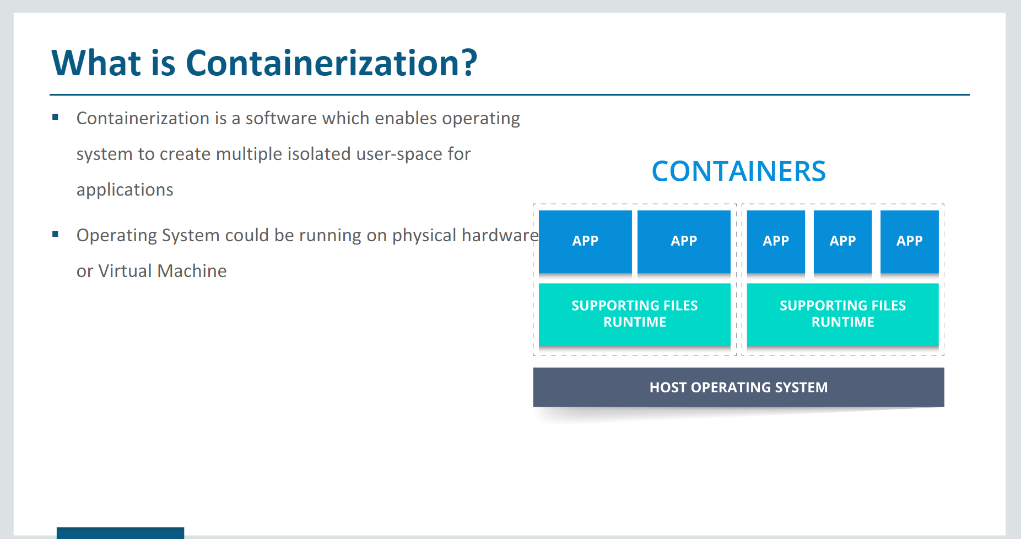

Slide 9
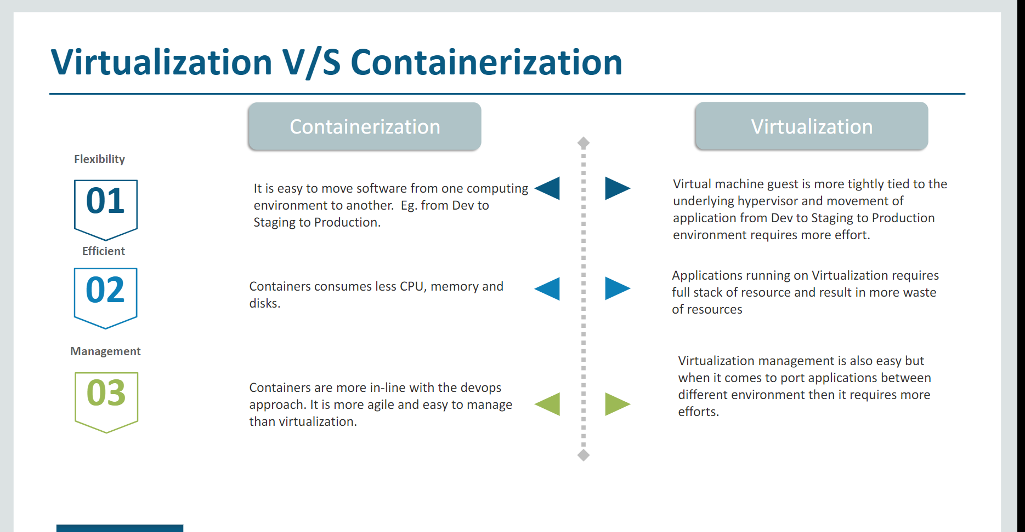

Slide 10
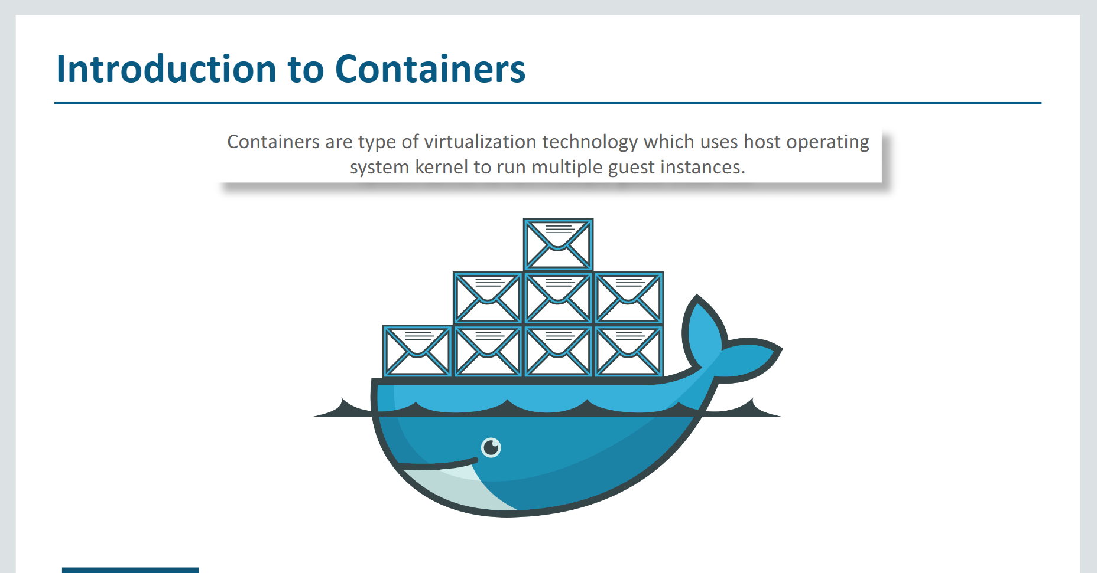

Slide 11
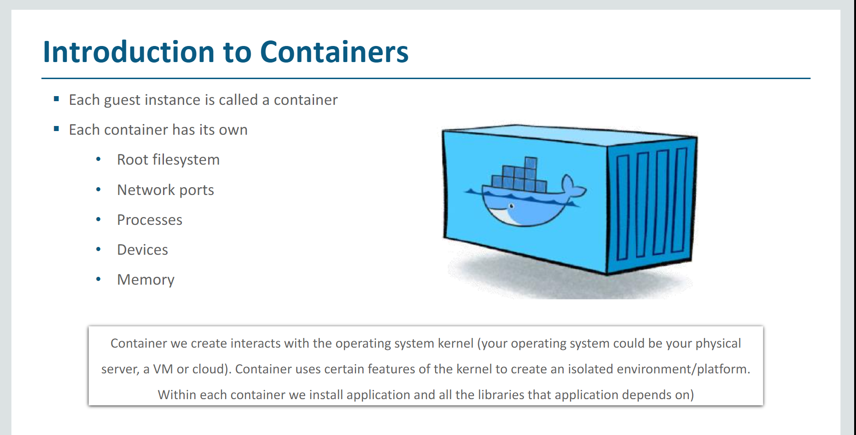

Slide 12
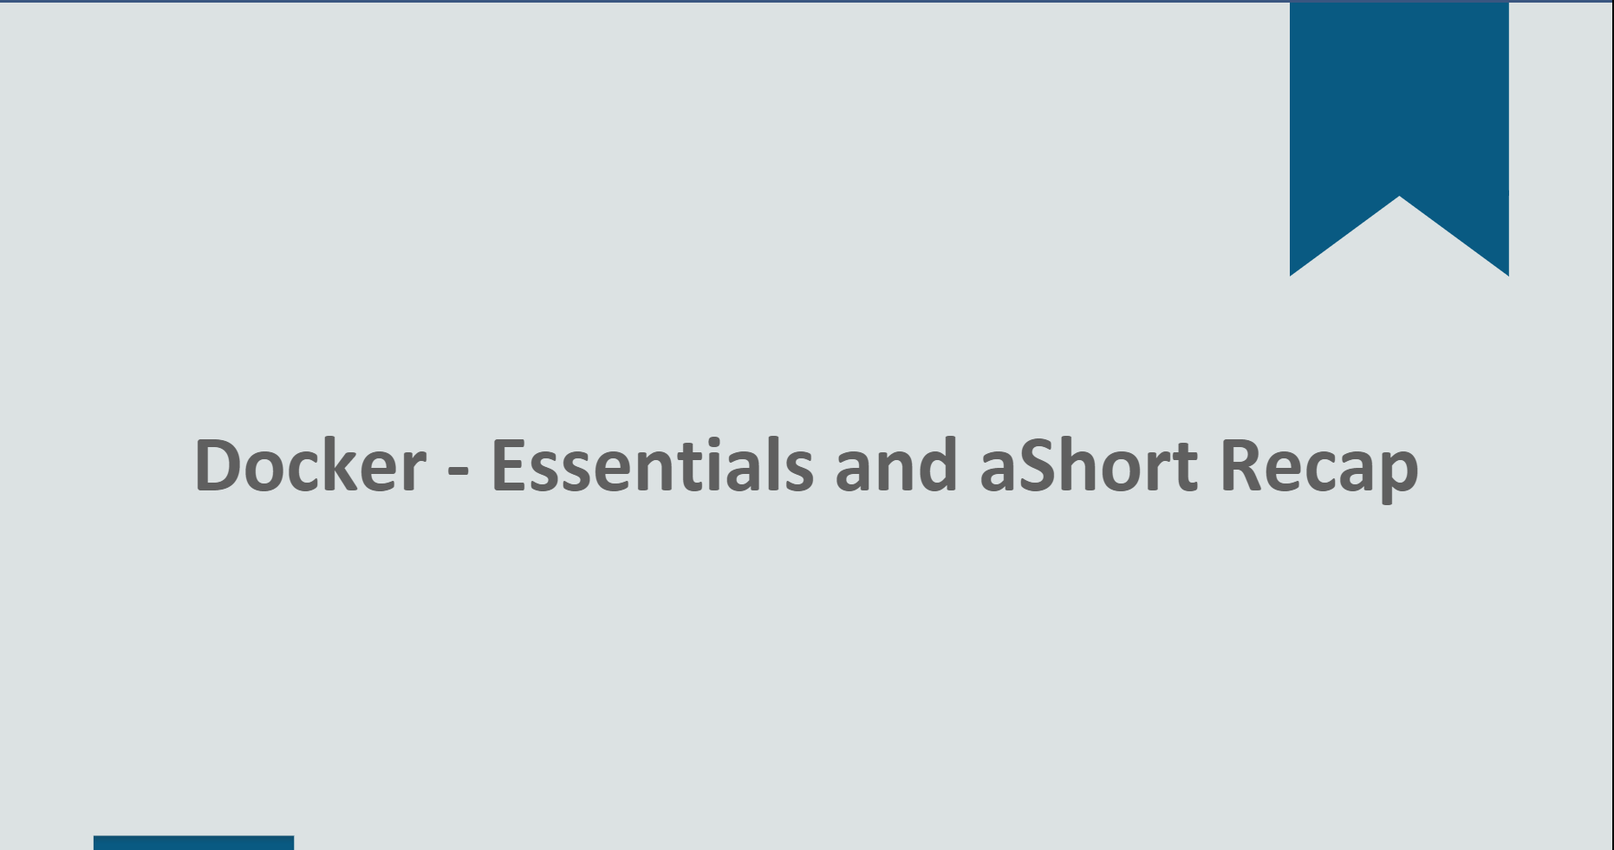

Slide 13
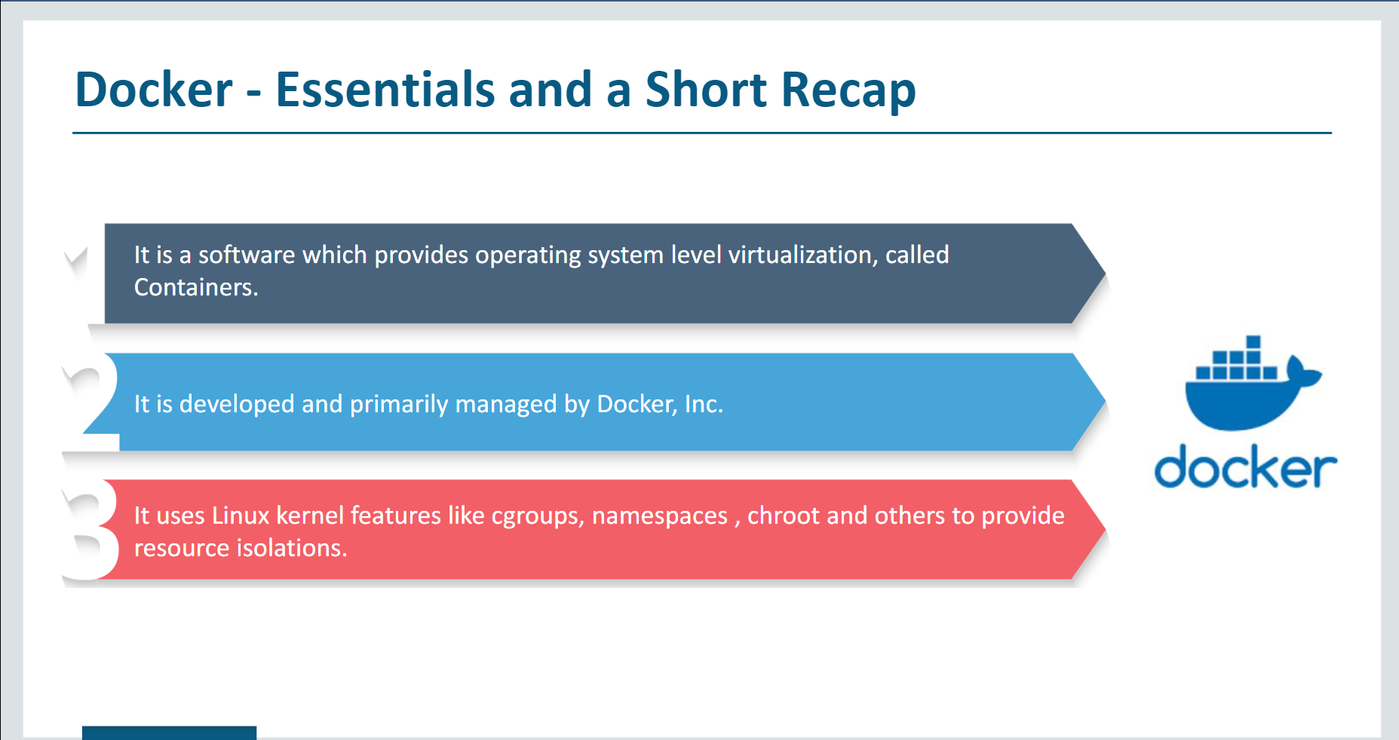

Slide 14
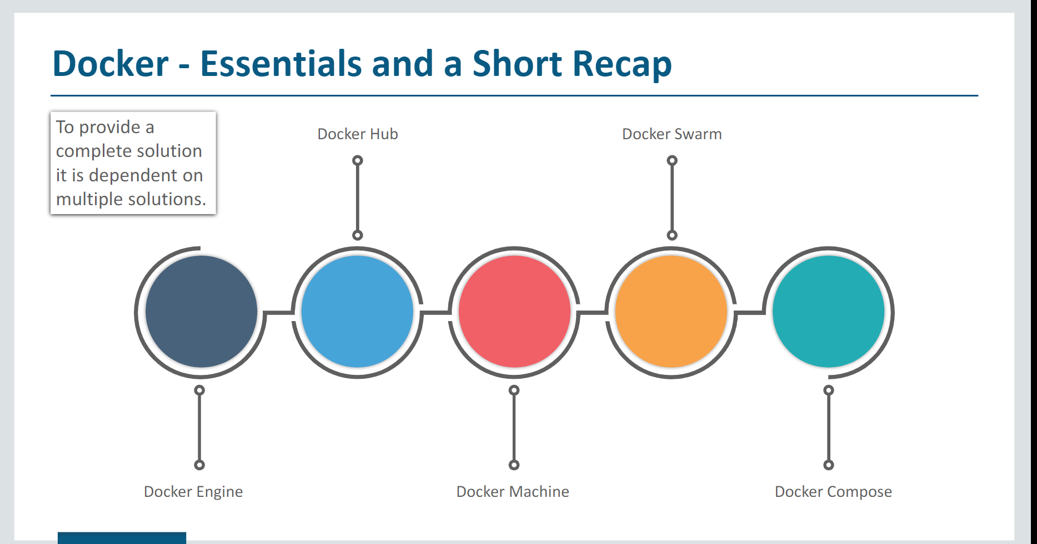

Slide 15
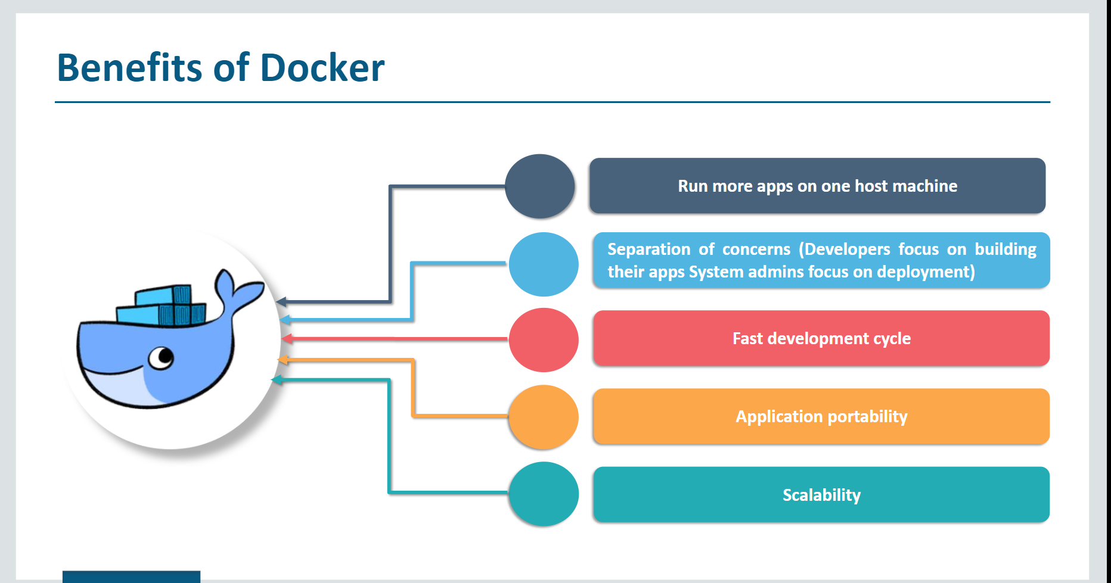

Slide 16
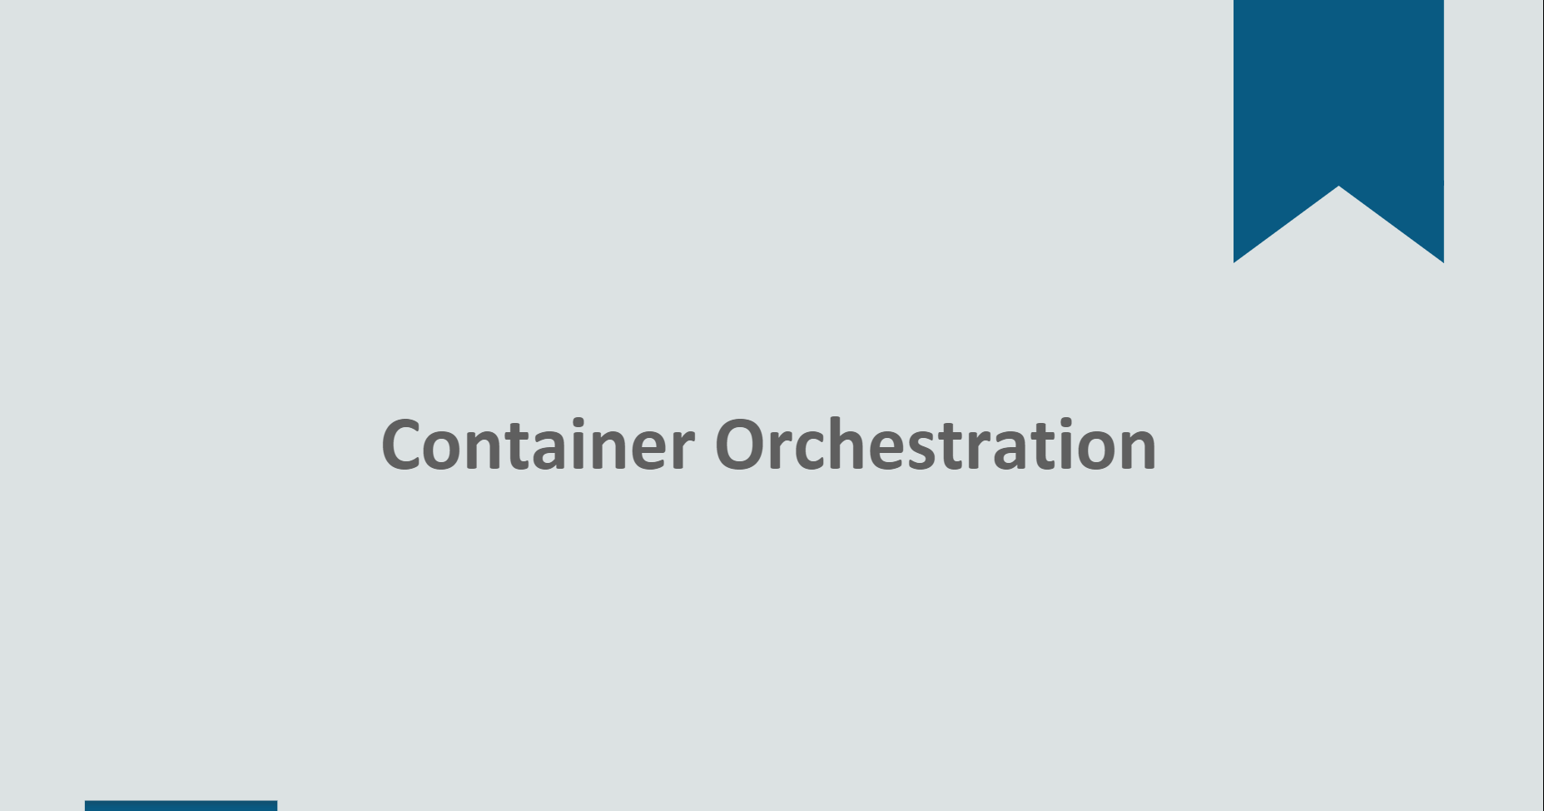

Slide 17
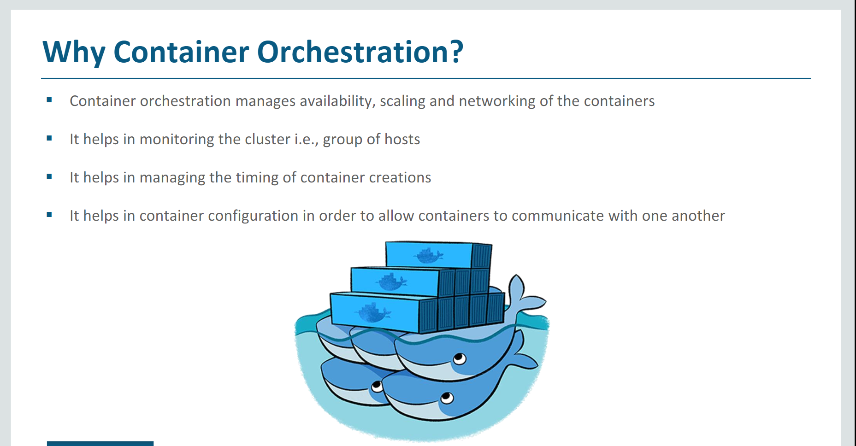

Slide 18
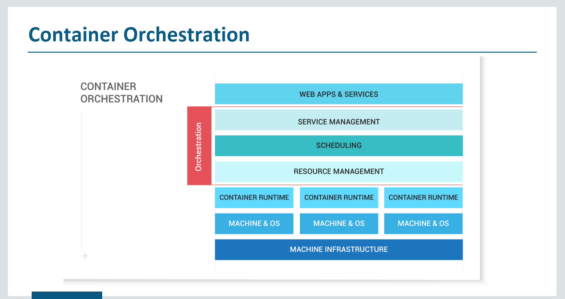

Slide 19
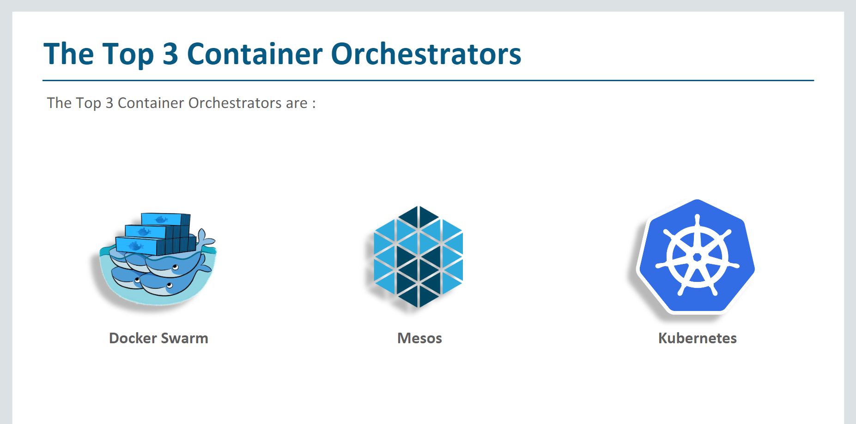

Slide 20
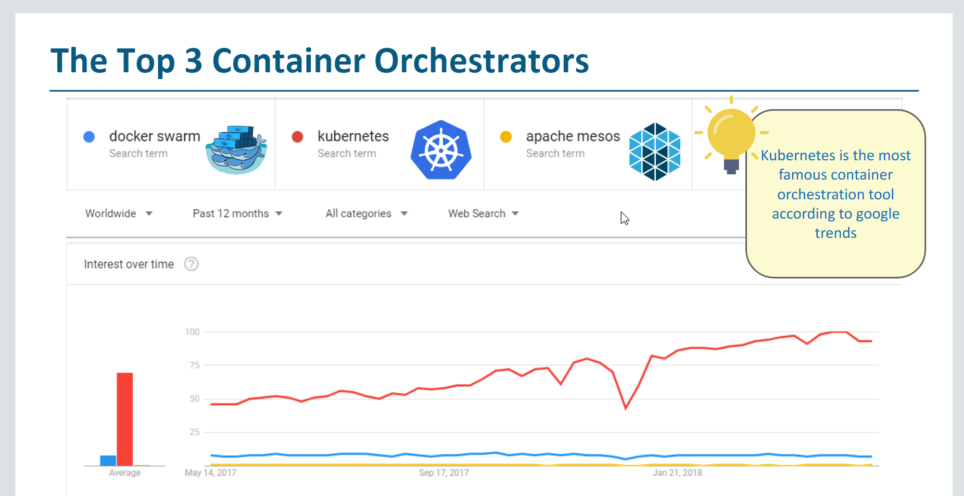

Slide 21
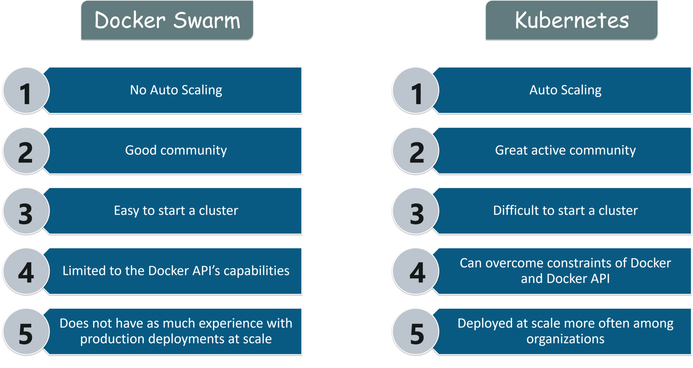

Slide 22
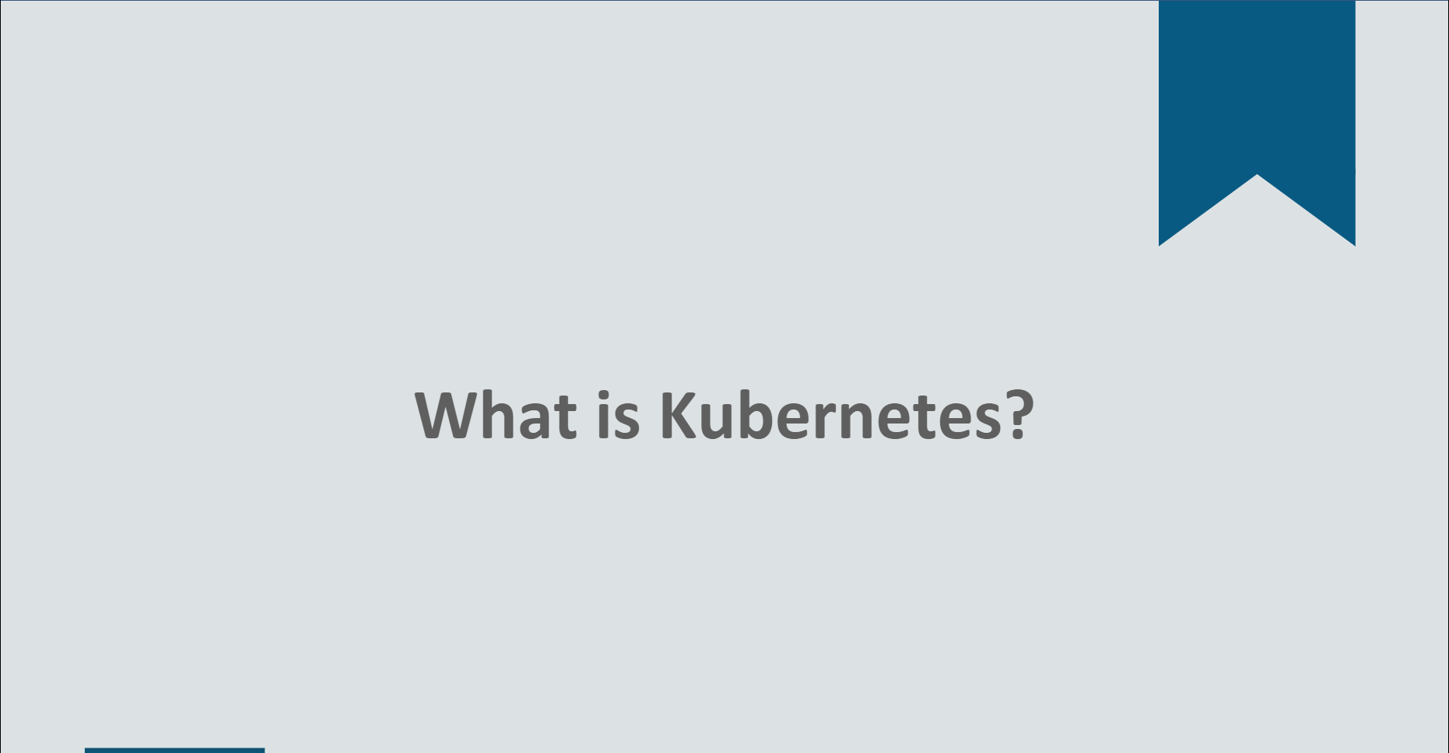

Slide 23
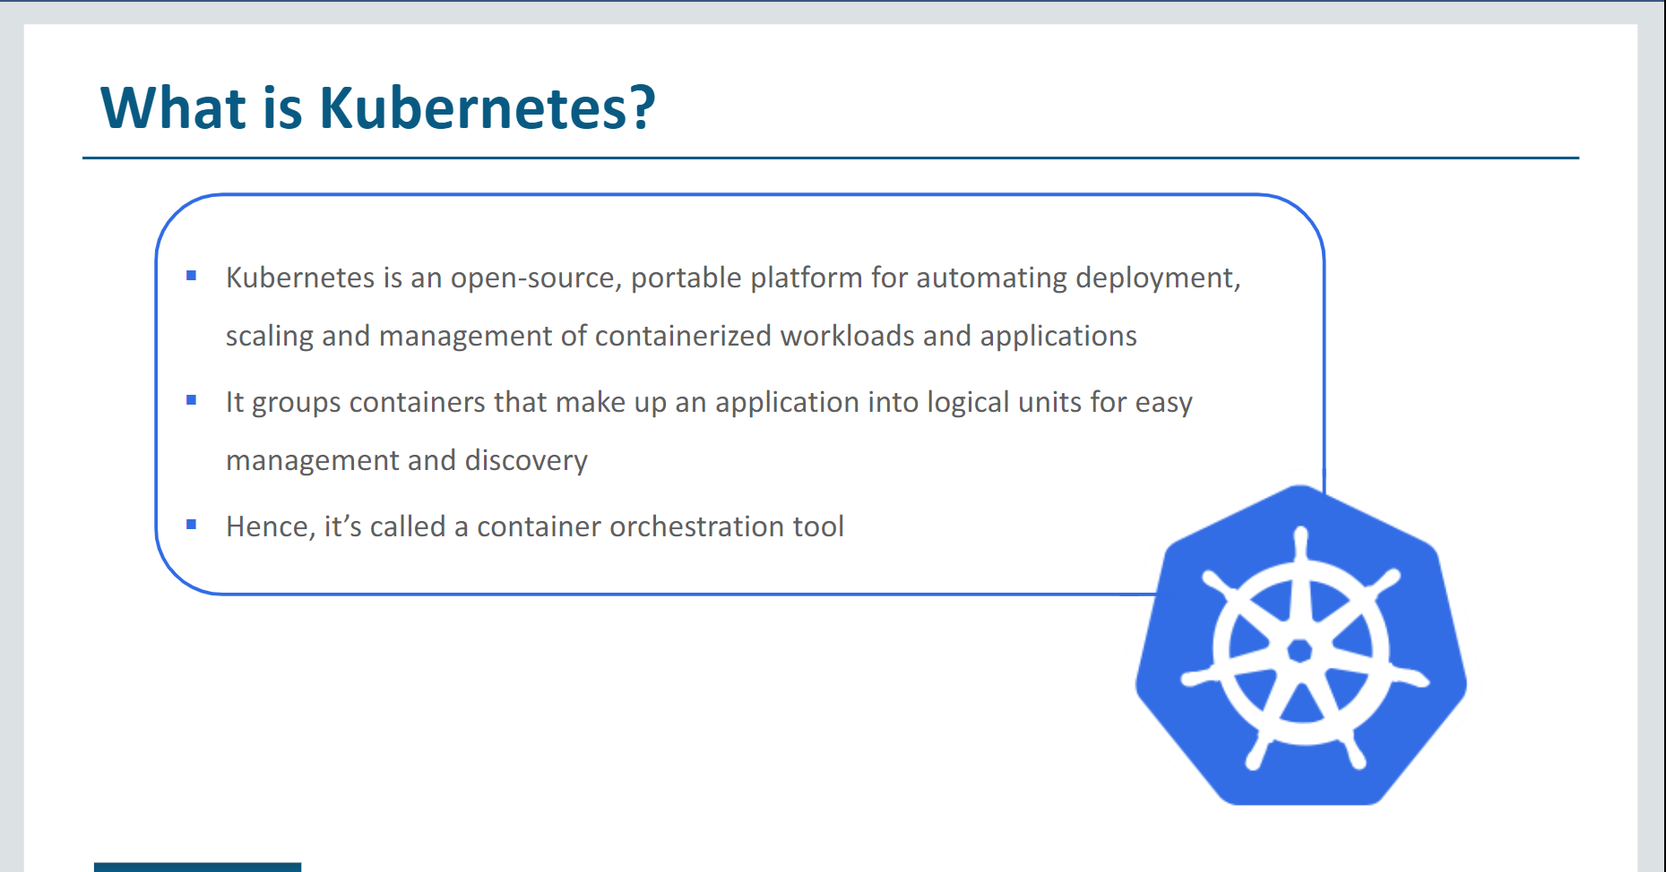

Slide 24
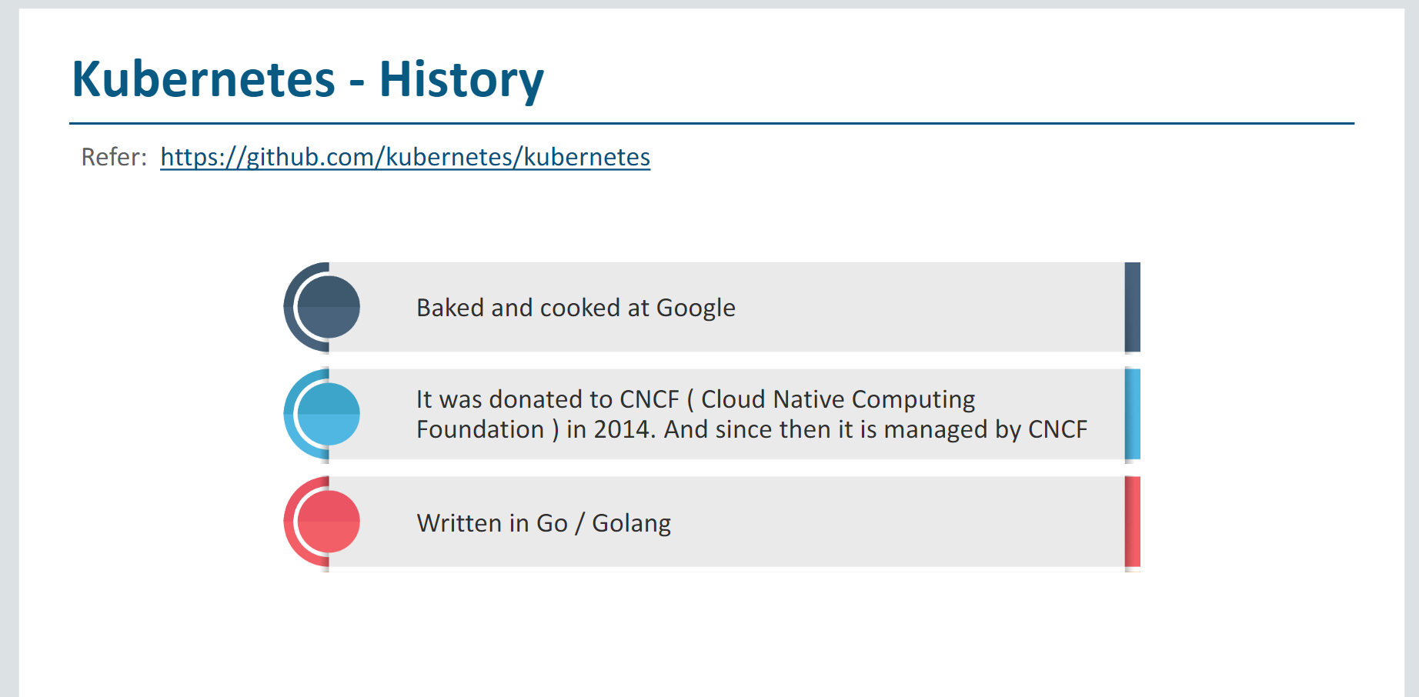

Slide 25



Implemented AKS to provision the PaaS for Aetna Case study- 1
A Leading HealthCare Insurance Aetna International implemented the AKS , cloud solution Azure to provision the PaaS.
Business Opportunity
Our Solution
Outcomes
Security of the artifacts
Classical driven Command Line Methodologies
Managing the Clusters
Update the servers and managing the proper Kubernetes versions
Not integrated with LDAP
Less Job Streamline features
Identity and security management
Integrated logging and monitoring
Auto Cluster node and pod scaling
Reduce Cluster node upgrades and Managements
Graphics Processing Unit GPU enabled nodes
Supports both static and dynamic storage volumes
Ingress with HTTP application routing support
Docker image support
Private container registry support
Automatically create Azure resources, such as an AKS cluster
Self healing and seamless auto upgrades
Built-in notification setup
Role based access control and integrated with LDAP and token based authentication
Reduction in licensing cost - PAYG Model, we needs to pay for Node VM only Master will be managed by Azure
High availability and security
Easily Integrated with All DevSecOps CI and CD Pipeline.
Continuous deployment / testing / rapid deployment
Automation / infra optimization
CI efficiency ,isolation and security
Increase Multi-Cloud Platforms
SERVICES
Smart Environments ; Lifecycle Analytics and Reporting ; Delivery Pipeline ; Release Automation

Slide 26



AETNA Container Enablement Framework
Setup
Installation & configuration of the target Container Infra architecture
Pilot
OUTPUT
Containerize
Launch a pilot project with defined timelines, building application images and deploying & testing the apps
Infra & App Image Hierarchy
Factory Based Containerization of workload in well-defined waves & groups
Container Arch. Setup
OUTPUT
OUTPUT
Pilot Analysis Report
Application HLD, LLD
Lessons Learnt
Containerization
Plan Document
Validation Reports
Assess
Improve
Containerization feasibility Analysis with Application Categorization & Grouping resulting in a Target architecture
Set up and run Service Operations- Monitoring; Orchestration & Automation with Policy-driven workload portability
OUTPUT
OUTPUT
Detailed inventory
Feasibility report
Secure & Compliant Container Operation - Steady State
Image hardening list

Slide 27
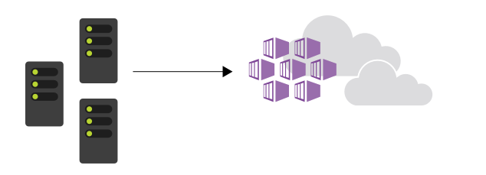
What is Azure Kubernetes Service (AKS)?
Azure Kubernetes Service (AKS) manages your hosted Kubernetes environment Cluster scaling for master nodes
Easy to
Use
AKS environment is enabled with features such as automated updates, self-healing, and easy scaling
Why AKS?
Easy to Manage
Create your cluster in the Azure portal or use the Azure CLI, PowerShell and ARM templates
Uses open
APIs

Slide 28
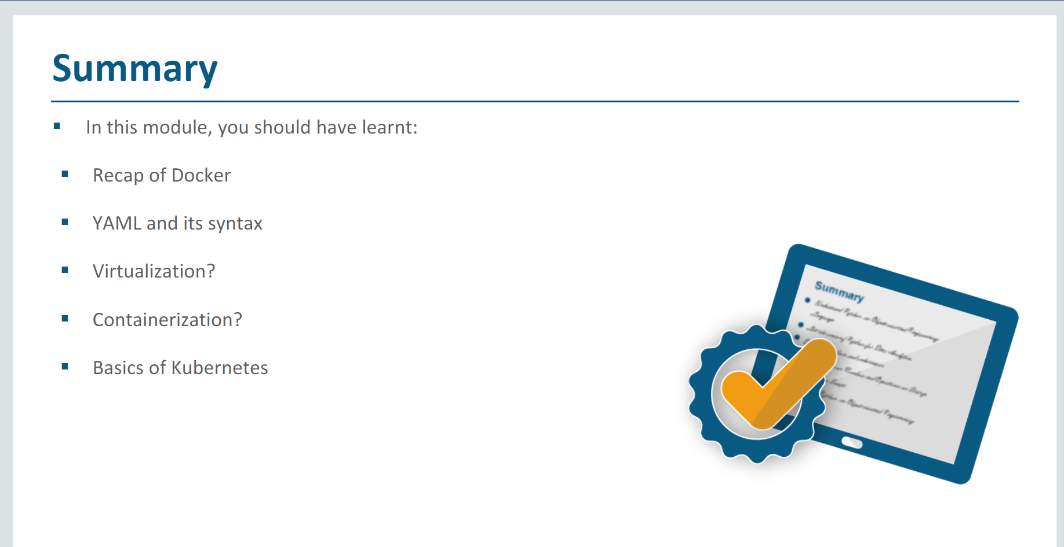

Slide 29

Q&A

